Slide 1
EE-451 - Image analysis and pattern recognition Interview exam
Tom Mery
MT-MA4
15.05.2023
Prof. Jean-Philippe Thiran

Slide 2
Part 1:
1. Present how to perform geometrical transformations of a digital image? Take the example of a translation of a non-integer number of pixels. (9%)
2. What is image restoration? In this context what is inverse filtering and what is a Wiener filter? (9%)
3. Explain what object labelling is and the algorithm to implement it. (9%)
4. What are the main principles of edge detection, and the two main families of methods to do edge detection? Present typical methods for each family. (9%)
5. What are the 4 main operators of binary mathematical morphology? Explain each of them. (9%)
6. What are the Fourier descriptors? (18%)
7. What is a Freeman code? (9%)
8. What is a morphological skeleton? (9%)
9. What is a Bayesian classifier? (principle, advantages & limitations, application to Gaussian cases) (18%)

Slide 3
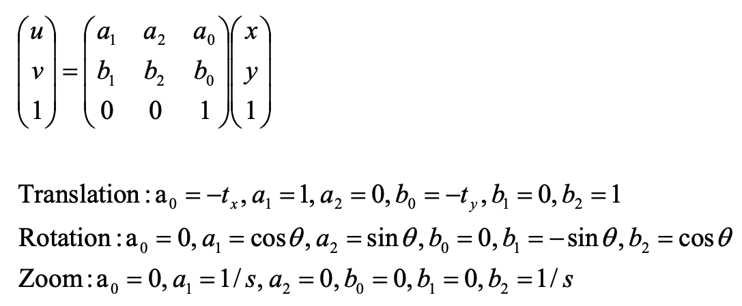
1.1. Geometrical transformations
Often used as pre-processing step
Several type of transformations: translation, rotation or scaling (zoom)
Linear transformations:
Notes:
When we do image processing, sometimes we want to change the geometry of the image (rotate it, translate it or deform it ).
For example, it can be very usefull in medical applications when we have images of the same scene coming from different machine and we want to compare then or overlap them.
So, geometrical transformations are often used as a pre-processing step.
There are several types of transformations for instance we have translation, rotation, and scaling.
All these 3 transformations can be represented as a linear transformation. So in a continuous 2D space, a linear transformation can be represented as a simple matrix multiplication where x and y are the original coordinate and u and v are the new coordinates after the transformation.
So we can basically perform translation, rotation and scaling by computing the right matrix and applying it to our coordinates. Here the only things that will change depending on the transformation we choose will be the coefficients of the matrix.

Slide 4
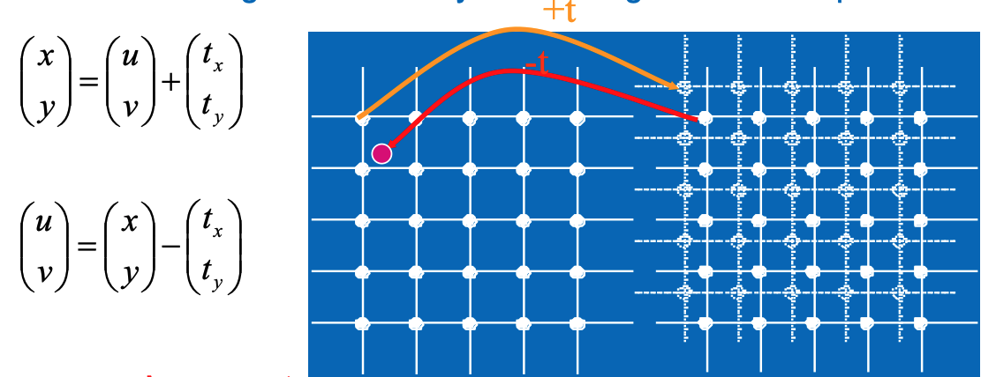
1.1. Translation of a non-integer number of pixels
Main idea: Inverse translation + interpolation
Notes:
The thing is that a digital image live in a discrete domain, and when we display an image on a computer screen, the screen has to remain where it is, the pixels don’t move.
Let’s take the example of the translation of a digital image. In this case what we actually want is to find the value to display at each pixel such that the results correspond to the translated version of the original image.
So here on both left and right images, in solid lines we have a fixed grid that corresponds to our screen. In dot we have the translated version of the original image. And so to find the right value to display at each pixel, what we can do is actually apply the inverse transformation on our original coordinates to find the points of interest and then interpolate to compute the right value to display.
The type of interpolation is something to be chosen depending on the quality/speed we want to achieve but it can goes from simple linear interpolation to more complicated process such that convolution with a sinc placed at the point of interest.
Doing so we can perform any translation of a digital image and espacially translation of a non-integer number of pixels.
And for rotation we actually do the same.

Slide 5
1.2. Image restoration
Definition: Dealing with a corrupt/noisy image in order to obtain the initial one. (invert non-wanted effects)
Motivation and intuition:
When there is not too much noise one can do a HP filter to enhance contours
Ideally one wishes to receive an image, calculate it’s spectrum, calculate the spectrum of the noise, and for each frequency decide if:
More noise than image information: Low pass filter
More image information than noise: High pass
We want a filter that adapts to the content of the image and the statistics of the noise.

Slide 6
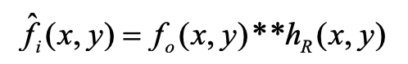
1.2. Mathematical formulation
Observed image:
Restored image:
Goal: find optimal restoration filter (hr)
By substitution:
By FT:
Notes:
fo is the observed image, fi is the ideal image that I would like to restore without corruption, hd is the degradation filter so it is the filter that the acquisition systems applied when taking the image and n is the noise.
So the observed image is computed as the convolution of the ideal image and the degradation filter plus the noise.
The goal is then to find the restoration filter hr such that if I convolve the observed image with the restoration filter I get back an image that is very close to the ideal image.

Slide 7
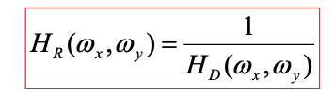
1.2. Naïve solution: Inverse filtering
Inverse filter:
Perfect restoration if no noise in ideal image (n=0)
If we have noise => noise will be boosted
Notes:
A naive solution would be to simply take the fourrier transform of hr as the inverse of the fourrier transform of hd. So if hd is a low pass filter, for instance we got a blured image, then hr is basically a high pass filter.
With this solution we get perfect restoration if the do not have noise in the added to the ideal image, so n = 0.
But if we do have noise, we will actually boost the noise and the restored image will become very noisy.

Slide 8
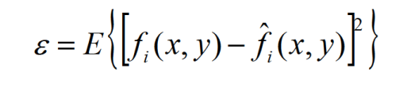
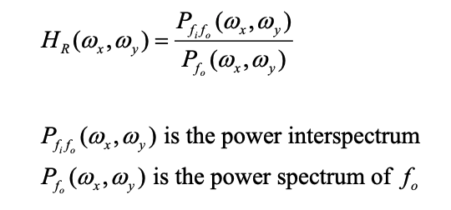
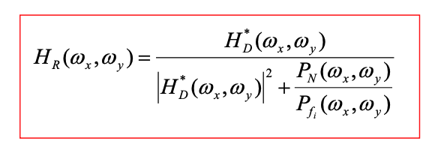
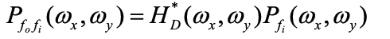
1.2. Wiener filtering
Goal: find a filter that minimizes the quadratic error between the original image and the restored one.
To solve, take the first derivative with respect to hr and set to zero. Using FT, this leads to:
Where:
Then use Wiener-Kintchine theorems:
Notes:
So if we cannot ignore the noise, what we can do is try to find a filter that minimizes the quadratic error between the original image and the restored one. Here hr is hidden in fi hat. To solve this we take the first derivative of the error with respect to hr and set it to zero. Then using the fourier transform the fourier transform of hr can be computed as the power interspectrum () divided by the power spectrum of fo. Then using the Wiener-Kintchine theorems we can express pfi and p fo fi as a function of hd, the power spectrum of the noise and the power spectrum of the ideal image and by substitution we finally get an the expression of the Wiener fileter.
What is important here is that this filter
If we have no noise in the system ,pn =0 and then we come back to the inverse filter as discussed before.
If we have a little some noise at a given frequency, the more noise we have, the bigger the term pn over pfi will be and will put the value of the filter down to zero.
And so this come back to the first intuition, for each frequency we calculate the power spectrum of the noise and the image, we compare them by computing the ratio and:
if we have more noise than image information then we don’t want to boost the noise so we want a low pass filter
If we have more image information than noise, then we want to apply a high pass filter.
So in summary, the wiener fileter is an adaptative band pass filter that take into account the amount of noise at each frequency in the power spectrums.

Slide 9
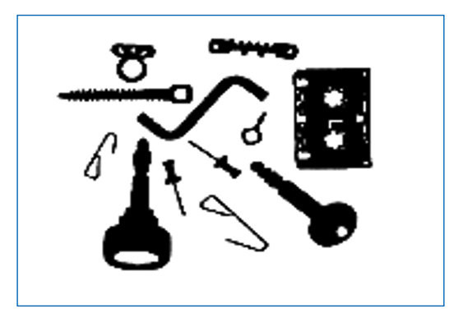
1.3. Object labelling
Object labelling: We want to give a label to objects (connected, coherent pixels) inside of an image.
Notes:
Let say we have this thresholded image that segments the foreground in the black end the background in white. For each pixel we know if it is part of the foreground or the background based on its intensity for example, but we do not know which pixels belong to the same region. We would like to group pixels that belongs to the same object and give them the same label. In this situation we can use a region based methods called region growing.

Slide 10
1.3. Region growing
Principe of region growing:
Fix a starting point (seed) in the desired region
Define the homogeneity criterion used to define the region
By a recursive procedure, (i.e. neighbor to neighbor), include in the region all the pixels that are neighbors of the current pixel and that satisfy the homogeneity criterion
By this, the region will grow until it contains all the points connected to the seed point
We obtain a connex region
Homogeneity criterion examples :
Intensity is lower than a threshold
Intensity difference between two neighbors varies lower than a threshold
The local variance is lower than a threshold

Slide 11
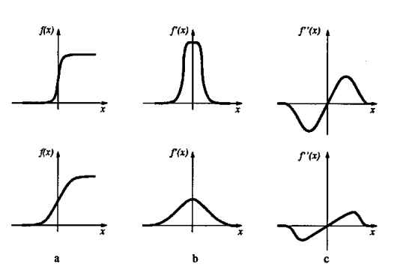
1.4. Edge detection
Edge: sharp transition in intensity.
Edge detection: method to extract the coordinates of the image where the transition in intensity is the highest.
2 ways:
1st derivative methods: find the maximum of the first derivative
2nd derivative methods: find the zero crossing of the second derivative
Notes:
Edge detection is part of contour-based segmentation methods where the goal is to separate objects from the background. An edge is a sharp transition in intensity, in other word it is a part of the image where there is an sharp transition between one gray level and another.

Slide 12
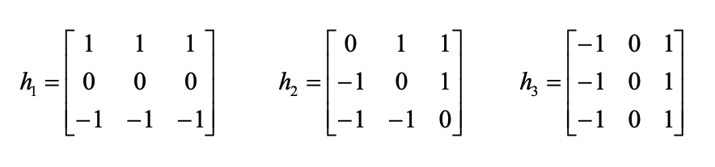
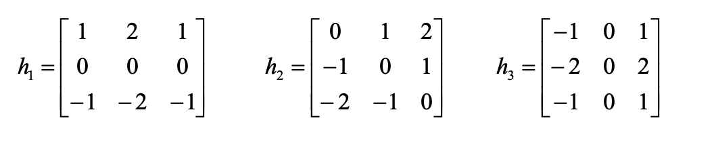
1.4. 1st derivative methods
First derivative methods:
High pass filters on the image, done by convolution with various kernels
Basically compute a finite difference approximation of the 1st derivative
Prewitt:
Sobel:

Slide 13
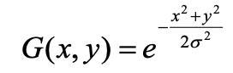
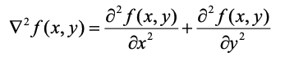
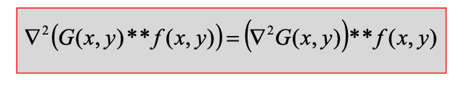
1.4. 2nd derivative methods
Second derivative methods:
Marr-Hildreth filter: Laplacian of gaussian filter
Main ideas:
Noise will introduce false detections
Filter the image to remove the noise and undesired details using gaussian filter:
Calculate the 2nd derivative of the filtered image (Laplacian operator):
Zero-crossing points of this filtered 2nd derivative are edge points
Trick: exploit the property of convolution:
Notes:
First using the second derivative instead of the first one can be a good idea beacause often it is easier to find zeros than a local maximum in a image.
The most popular solution way proposed by David Marr and use laplacian of gaussian filter.
The main ideas are as follow:
First we know that the noise will introduce false detections, but we may also want to decide which level of detail we want to keep and this can be done by applying a Gaussian filter before calculation of the second derivative and adjusting the value of sigma (the bigger the sigma, the bigger the smoothing).
Then we can compute the second derivative and find the zero-crossing points.
And here we can exploit the property of the convolution and we just have to convolve the image by the second derivative of a Gaussian and find the zero crossing of the resulting image.

Slide 14
1.5. Binary mathematical morphology
Motivation: often noise creates many problems after segmentation
Solution:
Fill the holes
Removes little dots
4 basics operators are:
Dilation
Erosion
Opening
Closing
Notes:
The main motivation of the mathematical morphology is to post-process the results of a segmentation method because often noise creates many problems such that artifact or holes in the segmented images.
So they are 4 basics operators which are dilation, erosion, opening and closing.

Slide 15
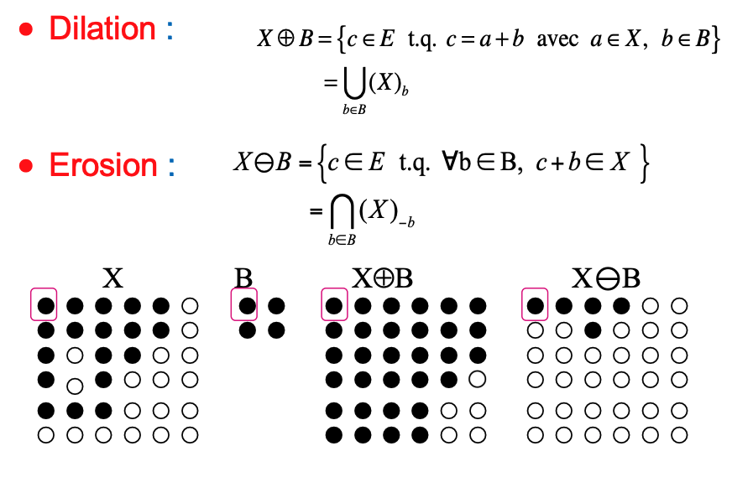
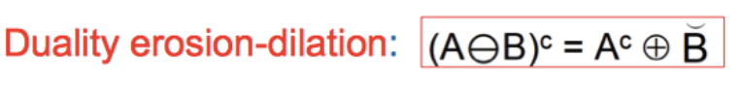
1.5. Dilation & Erosion
Notes:
So the main idea in mathematical morphology is to compare our image X by a structuring element B.
For dilation, the results of X dilated by B will be all the points in the image that can be written as the sum of a point of an object in X and a point of object in the structuring element. So here if we take X as a binary mask the results will be X union X translated by the vector (0,1) union X translated by (1,0) union X translated by (1,1). So the dilation is the union of the translation of X by all b in the structuring element. Dilation will close the holes that are smaller than the structuring element but the object will get bigger
On the opposite, the erosion will result in all the points in X such that those points stay in X after a translation of any b in the structuring element. So erosion is the intersection of the translation of X by all -b in the structuring element. This time, erosion will remove everything that is smaller than the structuring element.
Under some assumptions one can show that doing a dilation is equivalent to eroding the background.

Slide 16
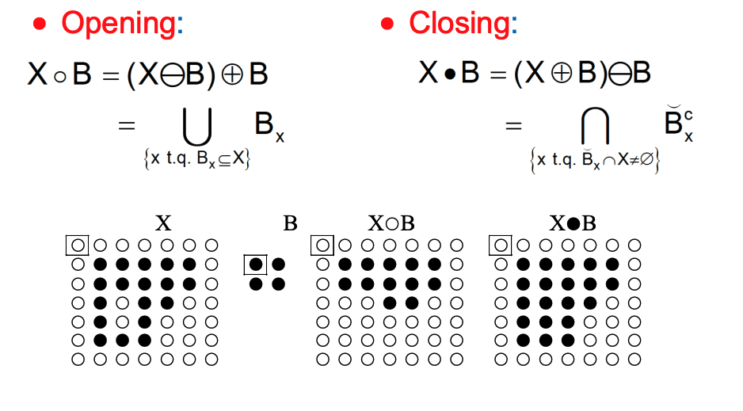
1.5. Opening & Closing
Notes:
An opening is an erosion followed by a dilation. This will keep the inside of the object
A closing is a dilation followed by an erosion. It “closes” the holes so it, first of all, dilates to close them, and then erodes to get back to the original shape.
So to summarize, Opening removes small objects while Closing Removes small holes.

Slide 17
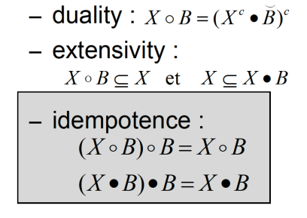
1.5. Properties

Slide 18
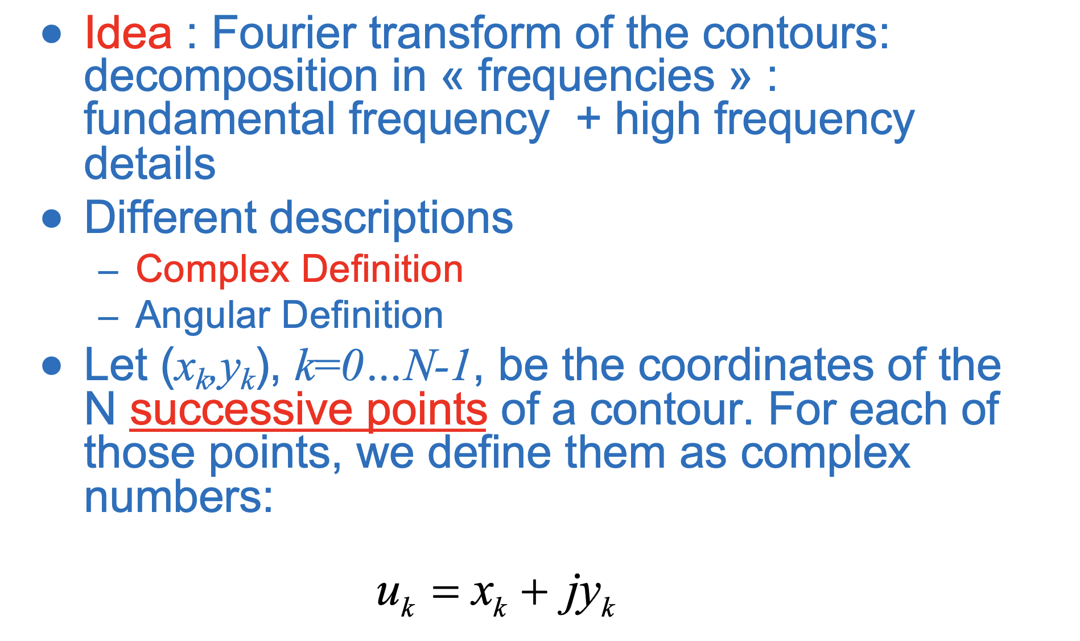
1.6. Fourier descriptors

Slide 19
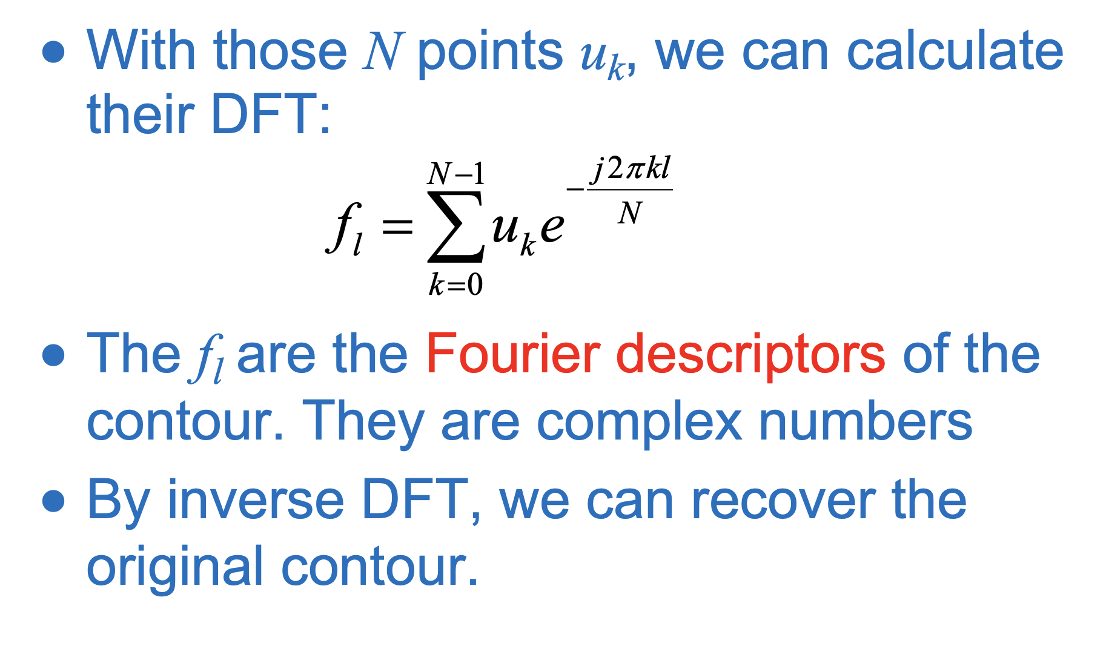
1.6. Fourier descriptors

Slide 20
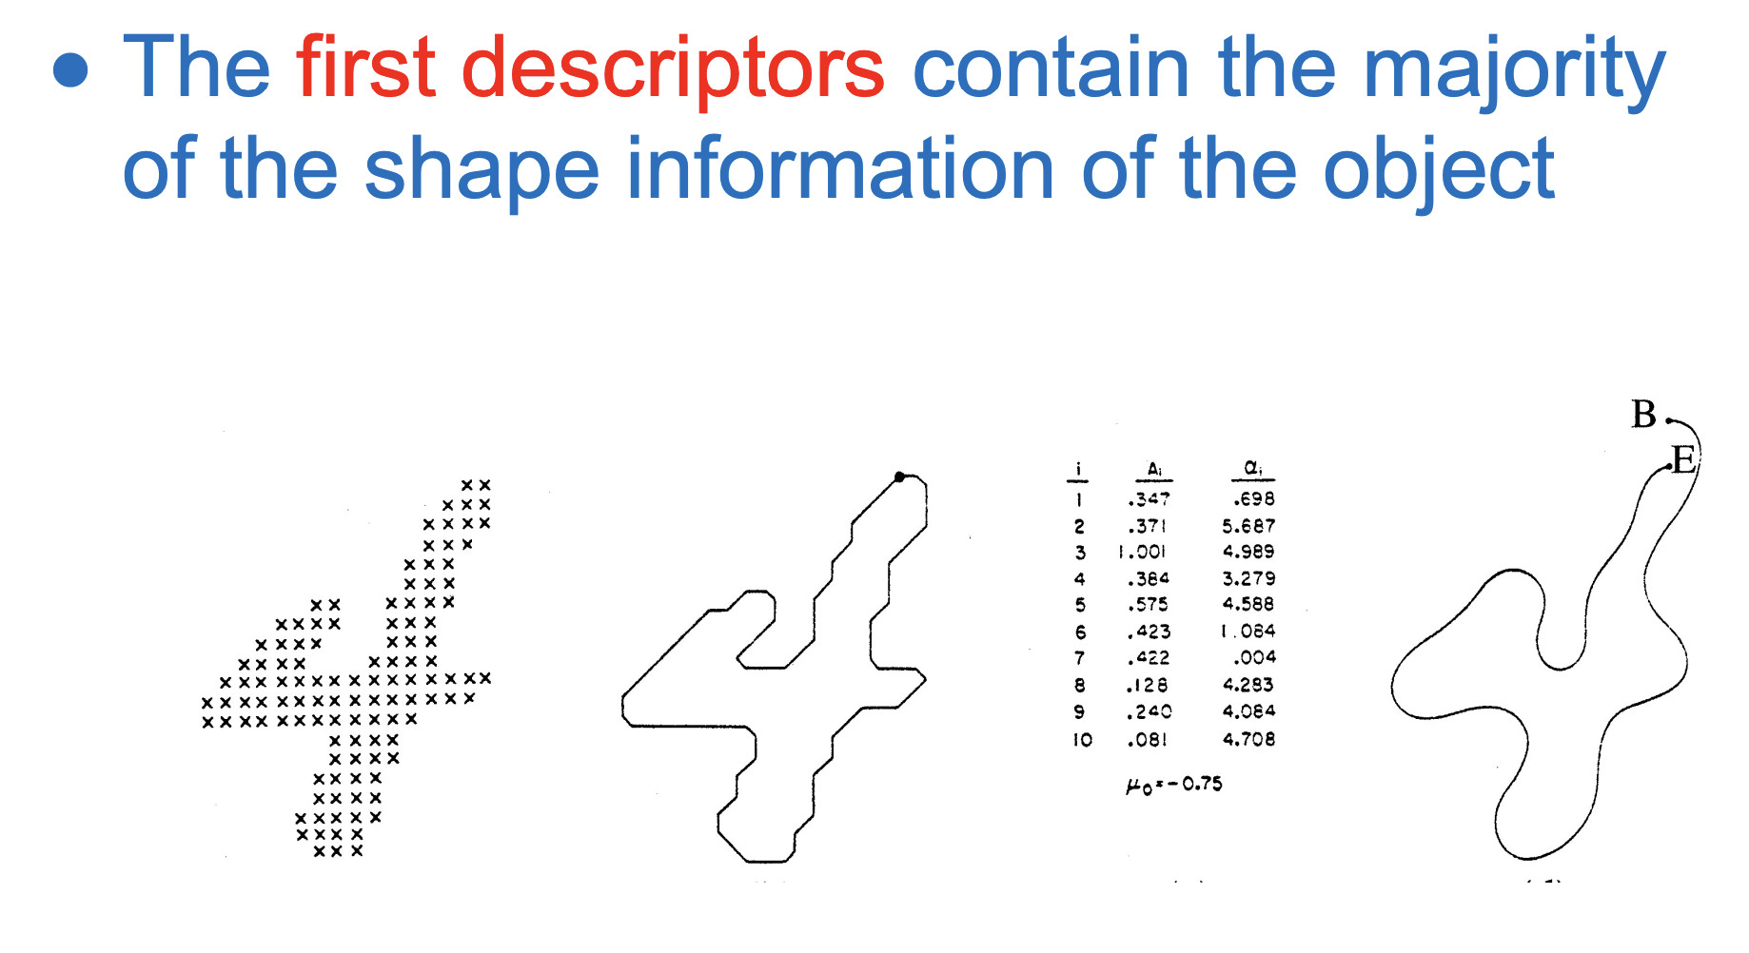
1.6. Fourier descriptors

Slide 21
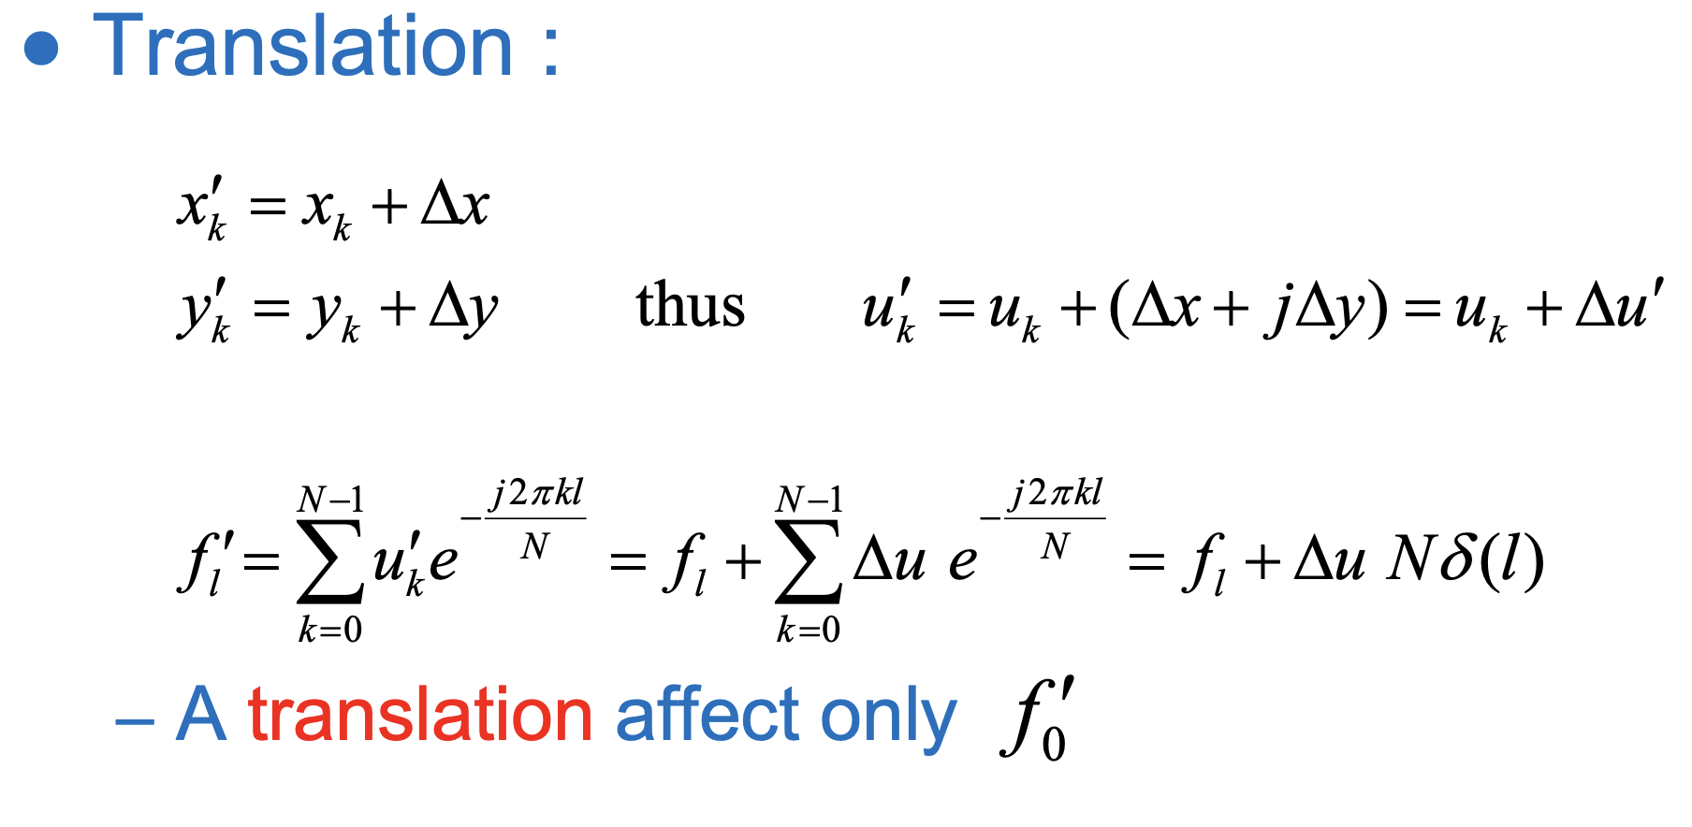
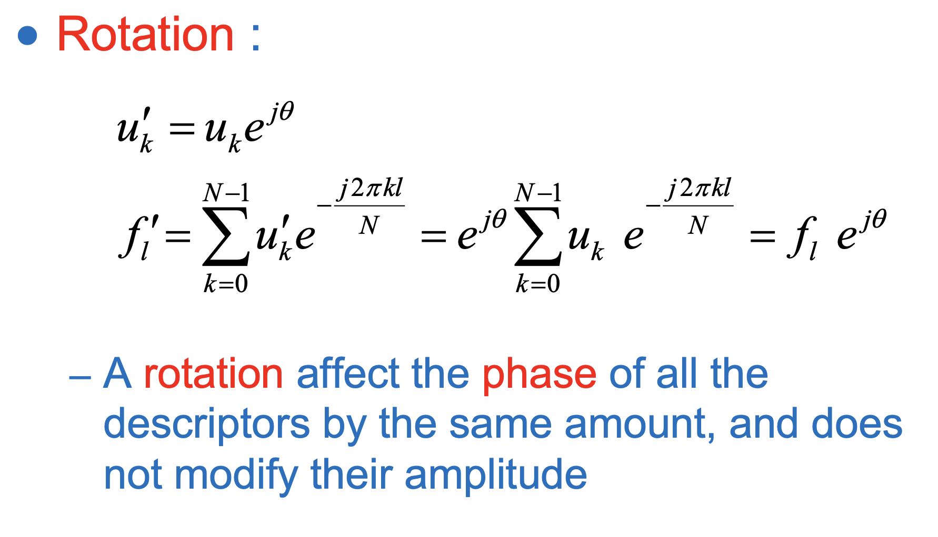
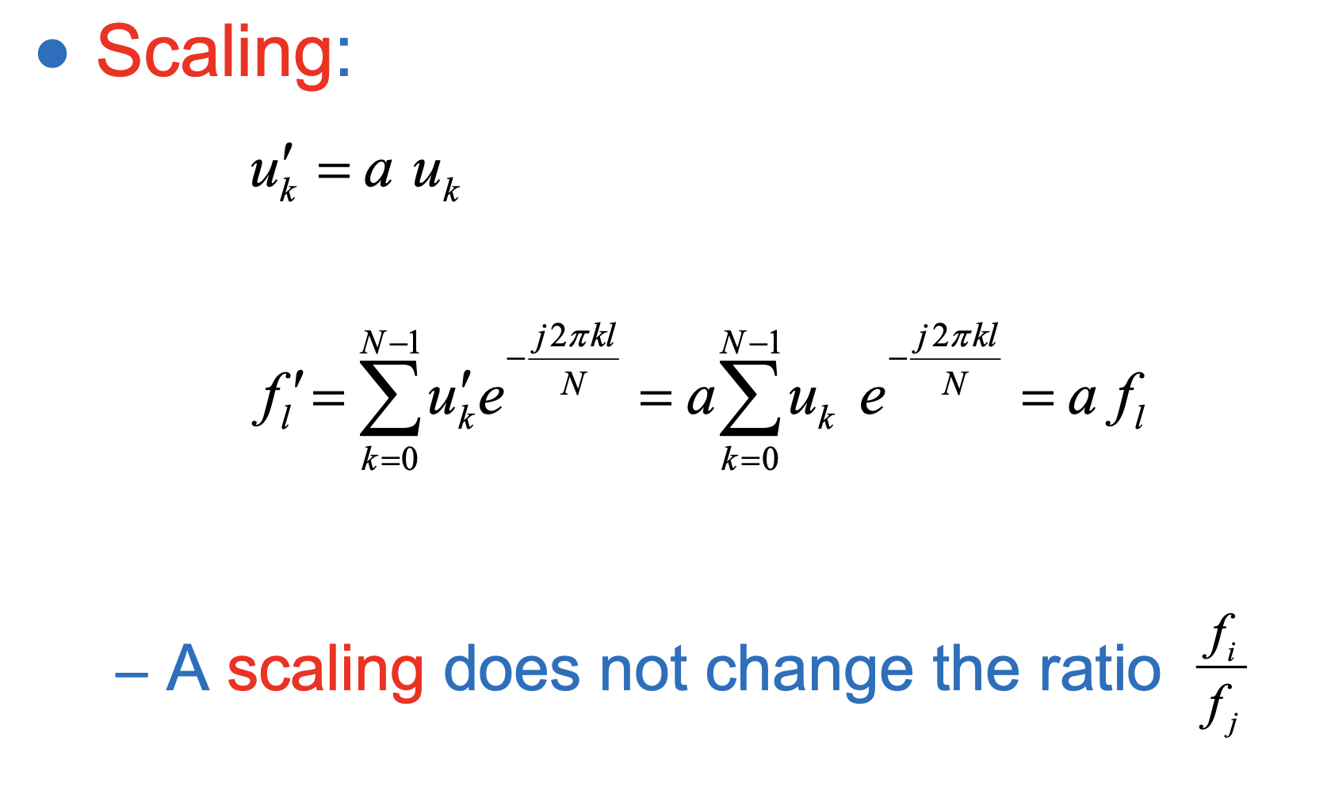
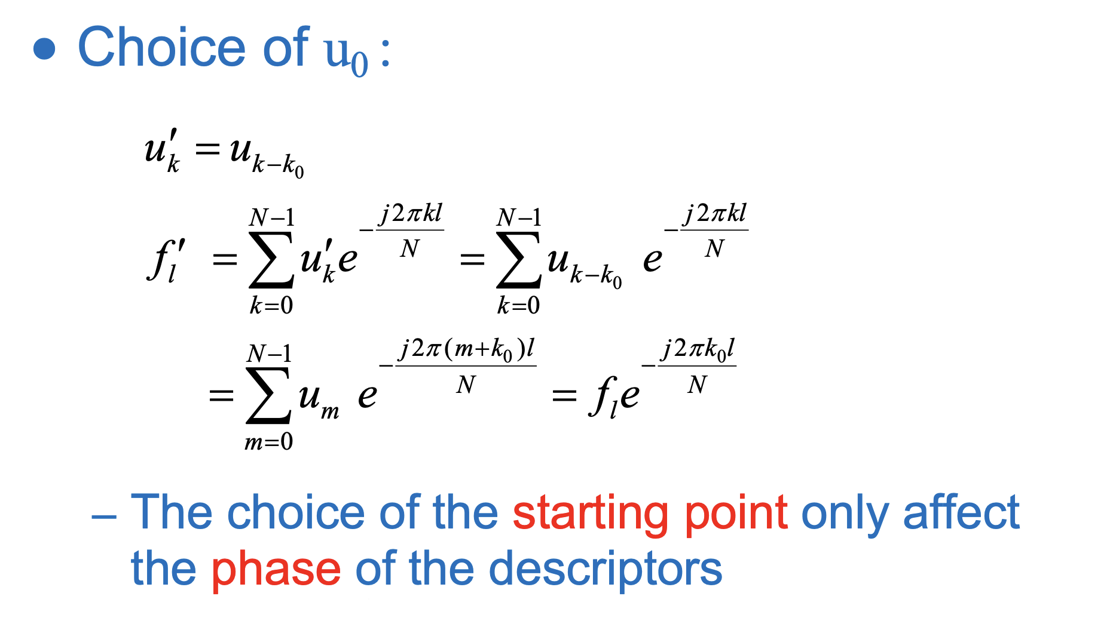
1.6. Properties

Slide 22
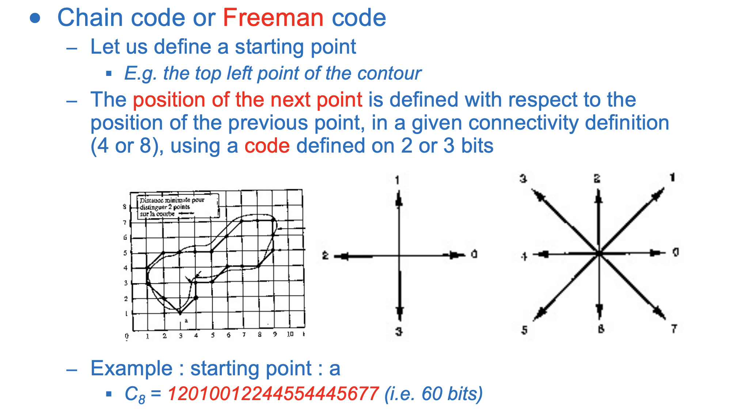
1.7. Freeman code
Notes:
The freeman code is a descriptor that represents the contour as a series of characters. From a starting position, the next point in the contour is coded by a number depending on which points of the eight directions it is linked regarding the point of interest. Explain the different direction coding
We’re able to store the contour in a very compact way because every point is coded on 3 bits maximum (0-7)

Slide 23
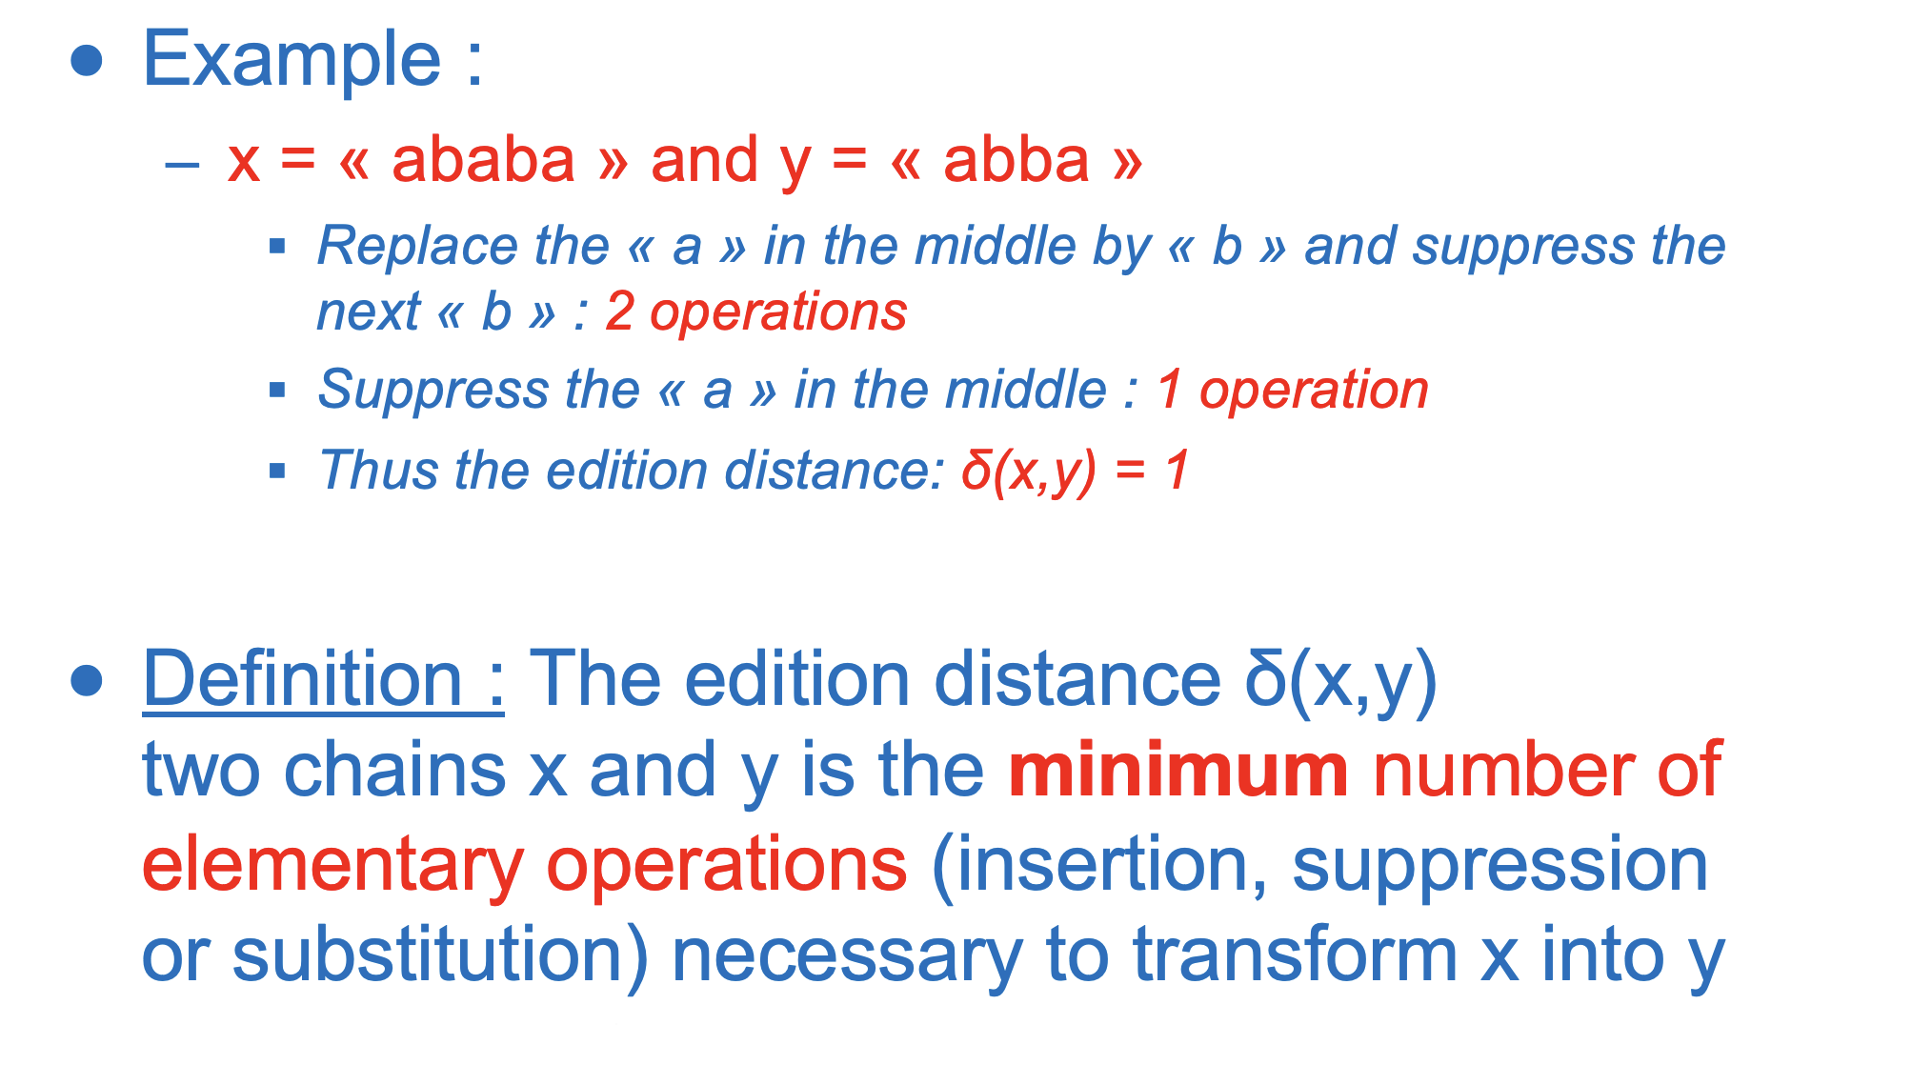
1.7. Edition distance
Notes:
We can then compare the chain of characters obtained by coding the contour to the chain of character of our objects (a cat or a dog for example). Two chains of characters are close if you can convert one to another using a small number of operations (edition distance).
Edition distance : (minimum number of elementary operations (insertion, suppression or substitution) that we have to do to convert one chain into the other)
Freeman code : Representation
Edition distance : Similarity, used to classify
Algorithm to calculate the edition distance: Fisher-Wagner algorithm, Find the minimum cost of operation iteratively.

Slide 24
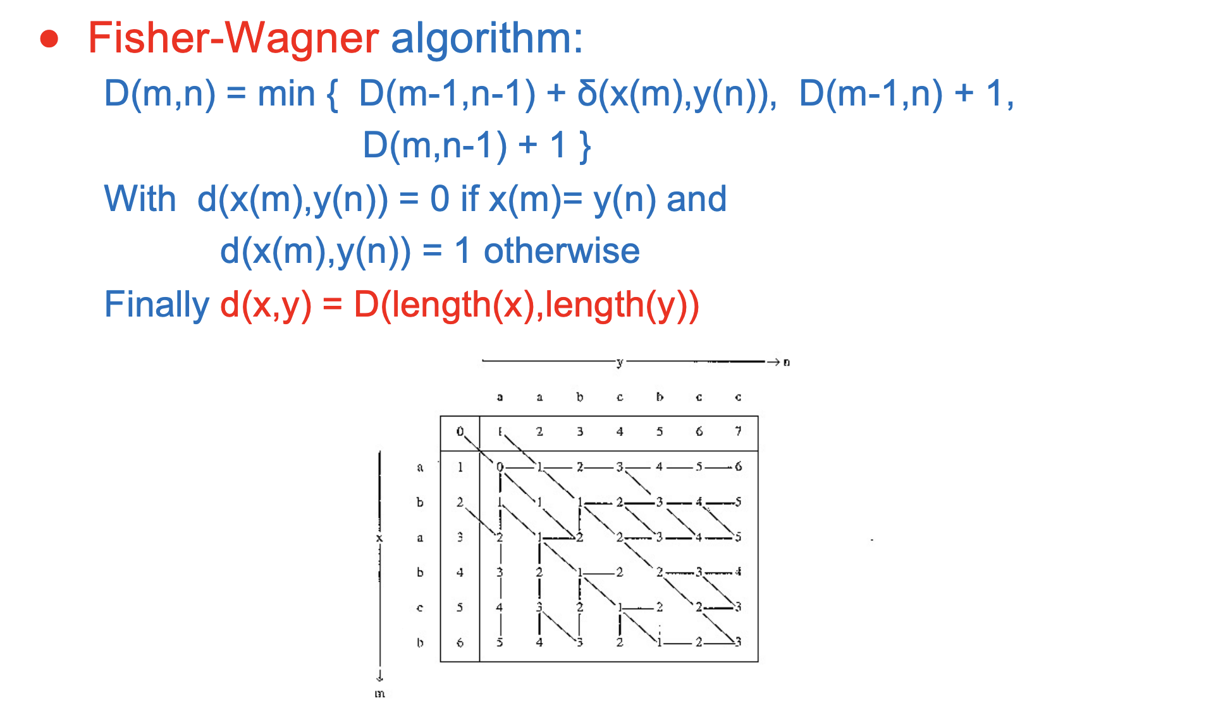
1.7. Fisher-Wagner algorithm

Slide 25
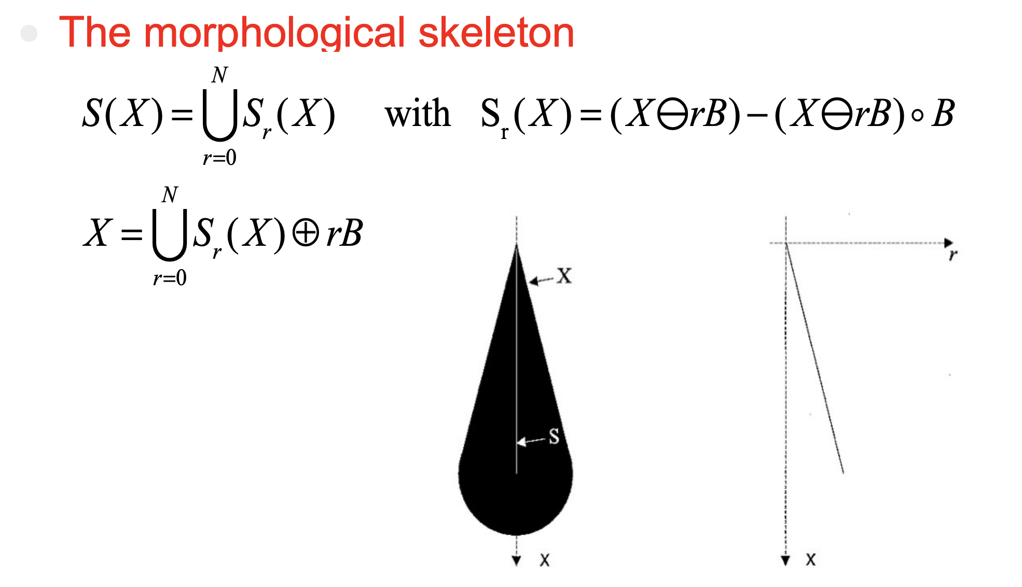
1.8. Morphological skeleton
Notes:
It is a representation of an image or a shape computed thanks to binary morphological operators. We are left with the skeleton, which is also called “medial axis”
-We use skeletons in order to achieve faster processing and use less memory.
S(X) is the Union of all Sr(X). Sr(X) is difference between: the object (X) eroded by a small kernel (B)*r (r is the “iteration”) and the object (X) eroded by a small kernel (B) * r, opened by the same kernel B
If you keep out skeleton and re-dilate the skeleton correctly (with the right size of the kernel), you can find the original image without losses:
Values where r is big mean that the initial shape of the image was large around that point.
If we want to compare general shapes, we can take the morphological skeleton and just discard parts where r is small (=parts of the shape that are thin) and compare only the parts of the skeleton where r is larger than a chosen threshold!

Slide 26
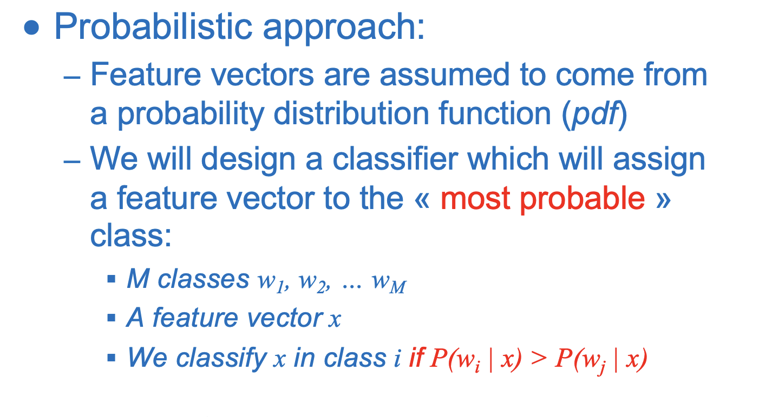
1.9. Bayesian classifier
Notes:
The goal is to classify a sample based on its probability to belong to a class.

Slide 27
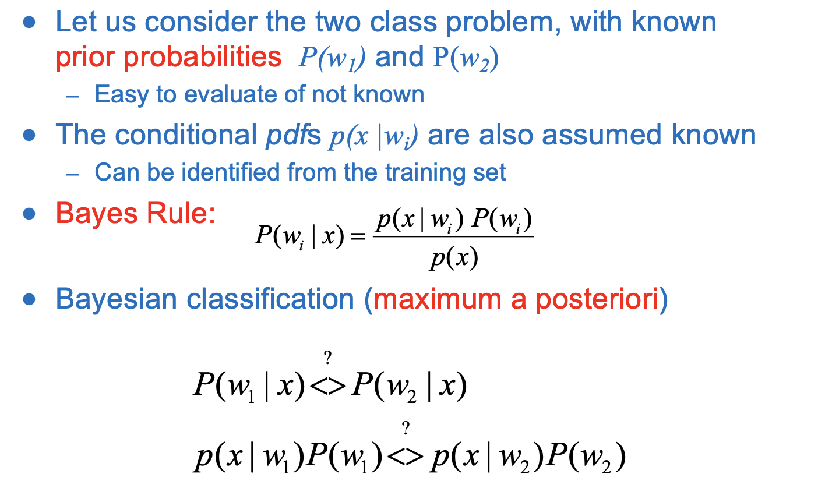
1.9. Bayesian classifier

Slide 28
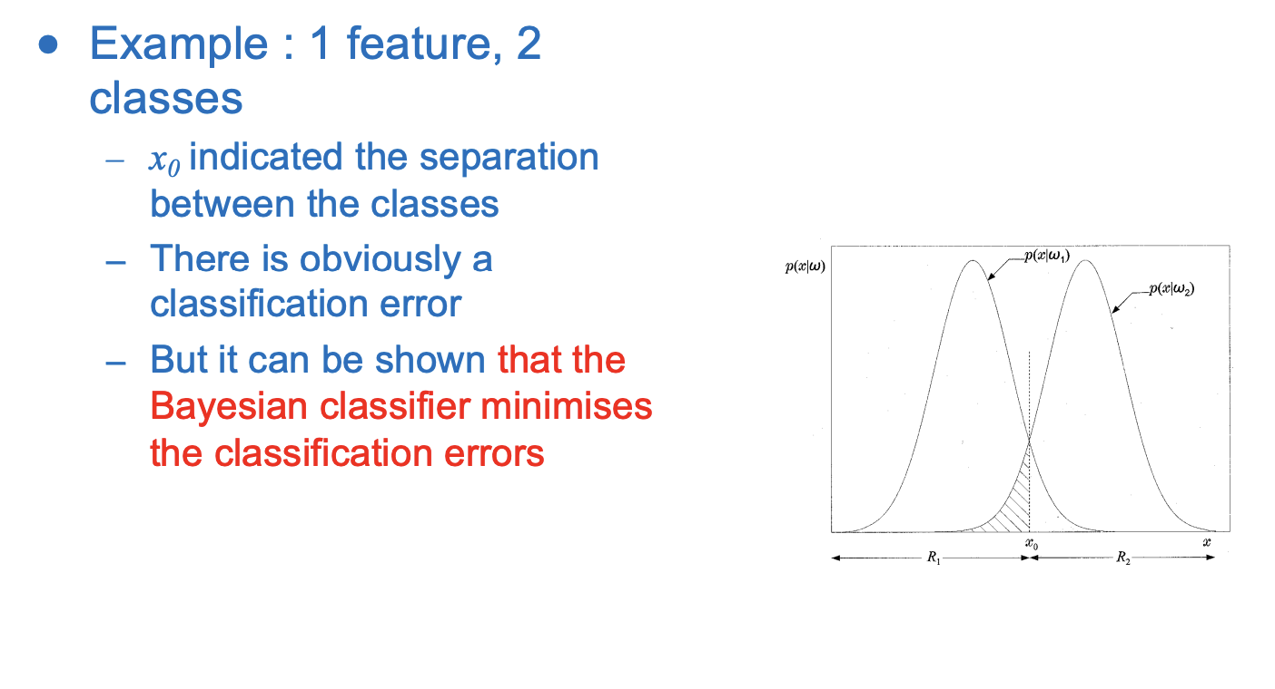
1.9. 1D example

Slide 29
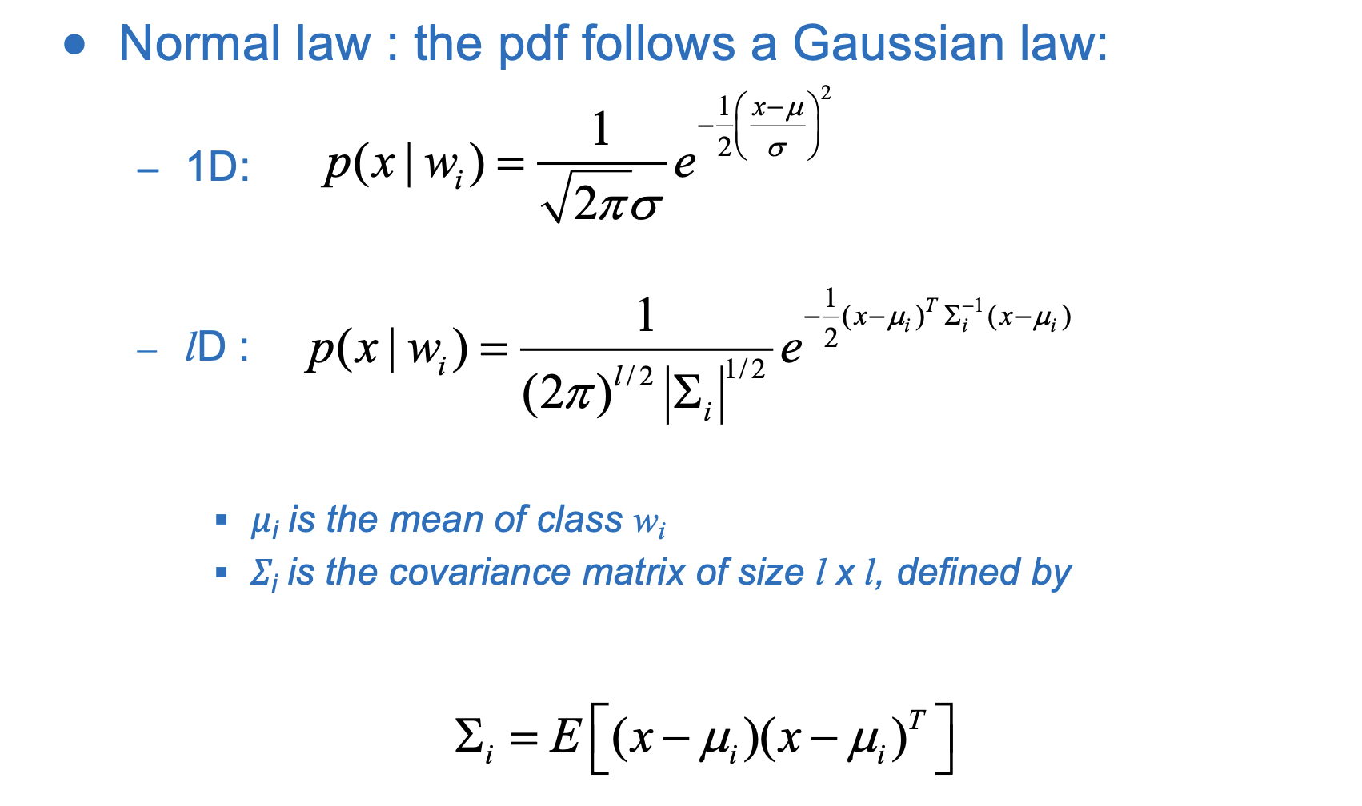
1.9. Gaussian assumption

Slide 30
Part 2:
1. What is a Median filter? (18%)
2. What is the Laplacian of Gaussian (LoG) method for edge detection? (9%)
3. How do we calculate the axes of inertia of a binary object? (9%)
4. What is an Euclidean distance classifier? (9%)
5. What is a Mahalanobis distance classifier? (9%)
6. What is a k-NN classifier? (9%)
7. What is a linear perceptron and how can we train it? (9%)
8. What is a Multi-layer perceptron? (9%)
9. What is supervised and non-supervised classification? (9%)
10. What is non-supervised classification and describe the k-means algorithm? (9%)

Slide 31
2.1. Median filter
Non-linear filter of size n
How it works:
For each pixel, take the neighbors of a pixel in a neighborhood of size n x n
Replace the value of the pixel by the median of the values of the neighborhood
Advantages :
Removes outliers, suppresses small variations
This filter works very well with “salt and pepper” noise (sharp and sudden disturbances)
Keeps the contours, they remain sharp
Disadvantages :
Computationally heavy → need to sort each time neighborhood

Slide 32
2.2. Laplacian of Gaussian
Second derivative edge detection methods:
Marr-Hildreth filter: Laplacian of gaussian filter
Main ideas:
Noise will introduce false detections
Filter the image to remove the noise and undesired details using gaussian filter:
Calculate the 2nd derivative of the filtered image (Laplacian operator):
Zero-crossing points of this filtered 2nd derivative are edge points
Trick: exploit the property of convolution:
Notes:
The Laplacian of Gaussian is edge detection methods that use the second derivatives to find the edges.
First, using the second derivative instead of the first one can be a good idea because often it is easier to find zeros than a local maximum in an image.
The most popular solution was proposed by David Marr and use laplacian of gaussian filter.
The main ideas are as follow:
First we know that the noise will introduce false detections, but we may also want to decide which level of detail we want to keep and this can be done by applying a Gaussian filter before calculation of the second derivative and adjusting the value of sigma (the bigger the sigma, the bigger the smoothing).
Then we can compute the second derivative and find the zero-crossing points.
And here we can exploit the property of the convolution and we just have to convolve the image by the second derivative of a Gaussian and find the zero crossing of the resulting image.

Slide 33
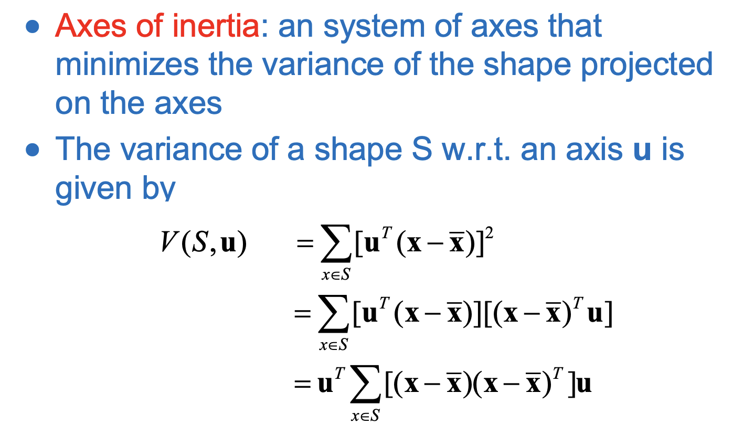
2.3. Axes of inertia of a binary object
Notes:
System of axes that minimizes the variance of the shape when projected on the axes
Mechanical analogy: Axes around which the object rotates with minimum moments: used in physics to describe the mass repartition of a body

Slide 34
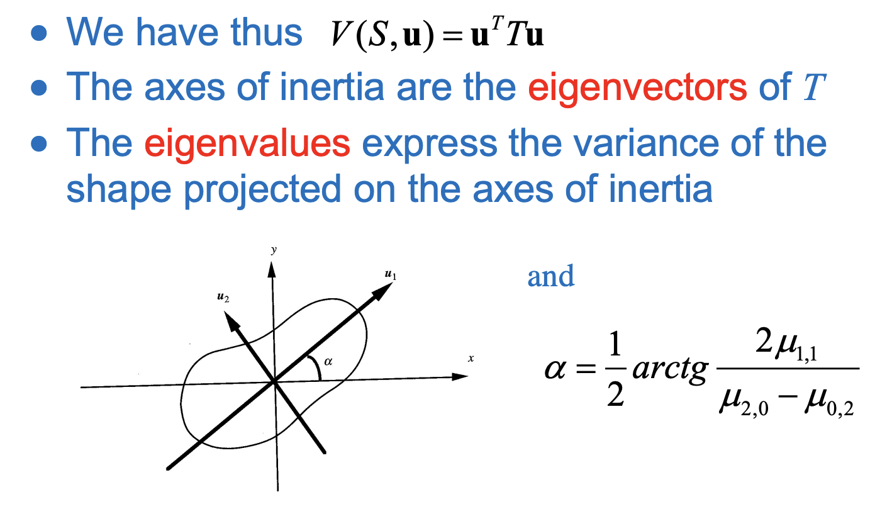
2.3. Axes of inertia of a binary object

Slide 35
2.4. Euclidean distance classifier
The Euclidean distance classifier classifies a point x to the class that minimizes the euclidean distance between the means.
The Euclidean distance classifier is a special case of the Bayesian classifier that is optimal when we make several assumptions:
The distributions of the classes are gaussians
The covariance matrices are the same for all the gaussians
The covariance matrices are isotropic
The priors are equal for each class

Slide 36
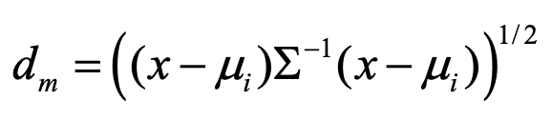
2.5. Mahalanobis distance classifier
The Mahalanobis distance classifier classifies a point x to the class that minimizes the mahalanobis distance between the means
The Mahalanobis distance classifier is a special case of the Bayesian classifier that is optimal when we make several assumptions:
The distributions of the classes are gaussian
The covariance matrices are the same for all the gaussians
The covariance matrices are not isotropic
The priors are equal for each class

Slide 37
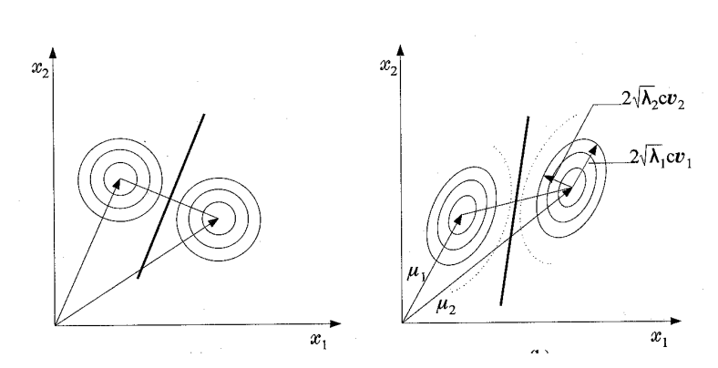
2.5. Euclidian vs Mahalanobis

Slide 38
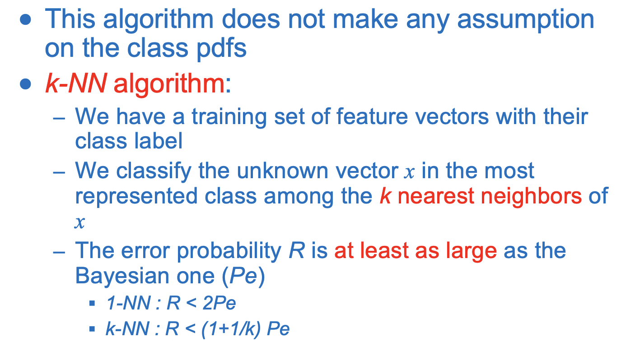
2.6. K-NN classifier

Slide 39
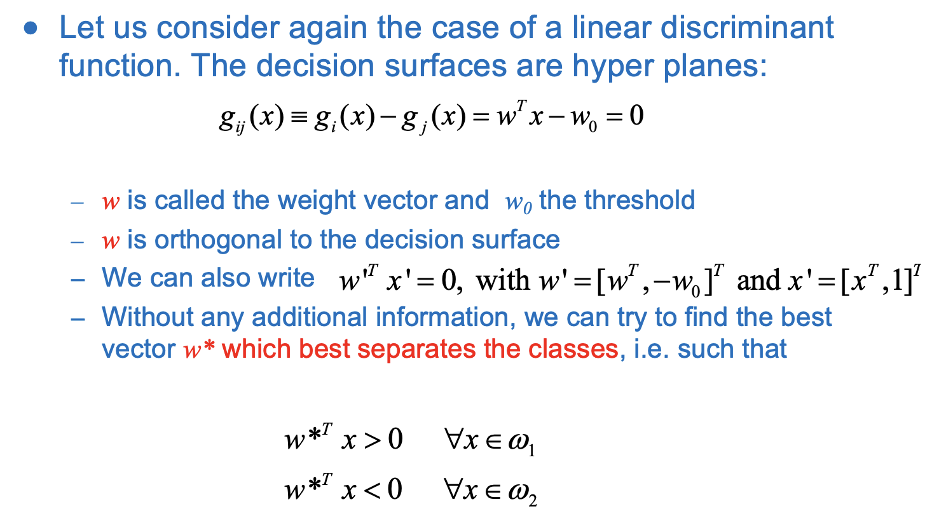
2.7. Perceptron = Linear classifier

Slide 40
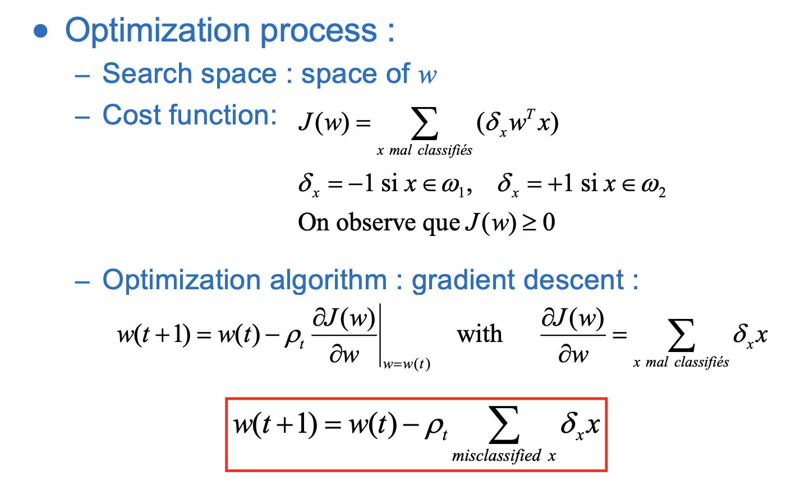
2.7. Perceptron

Slide 41
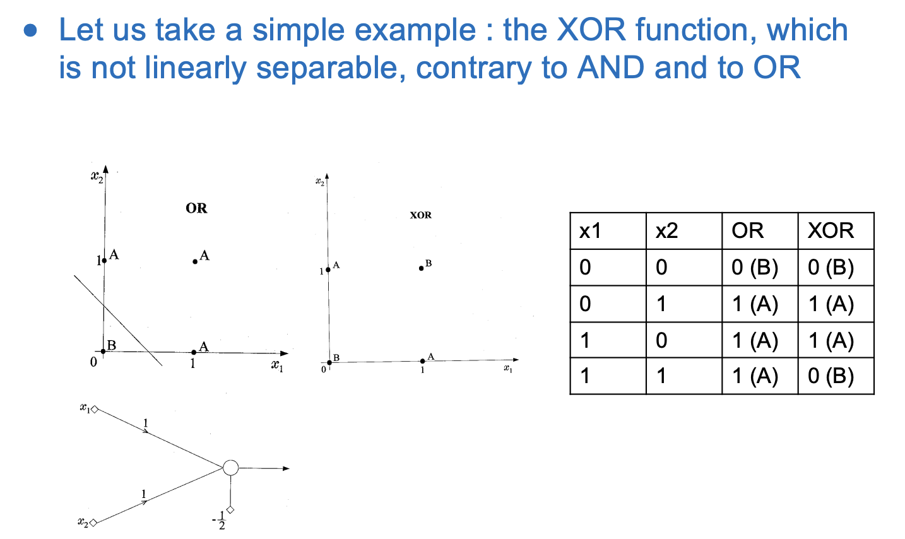
2.8. Multi-layer perceptron

Slide 42
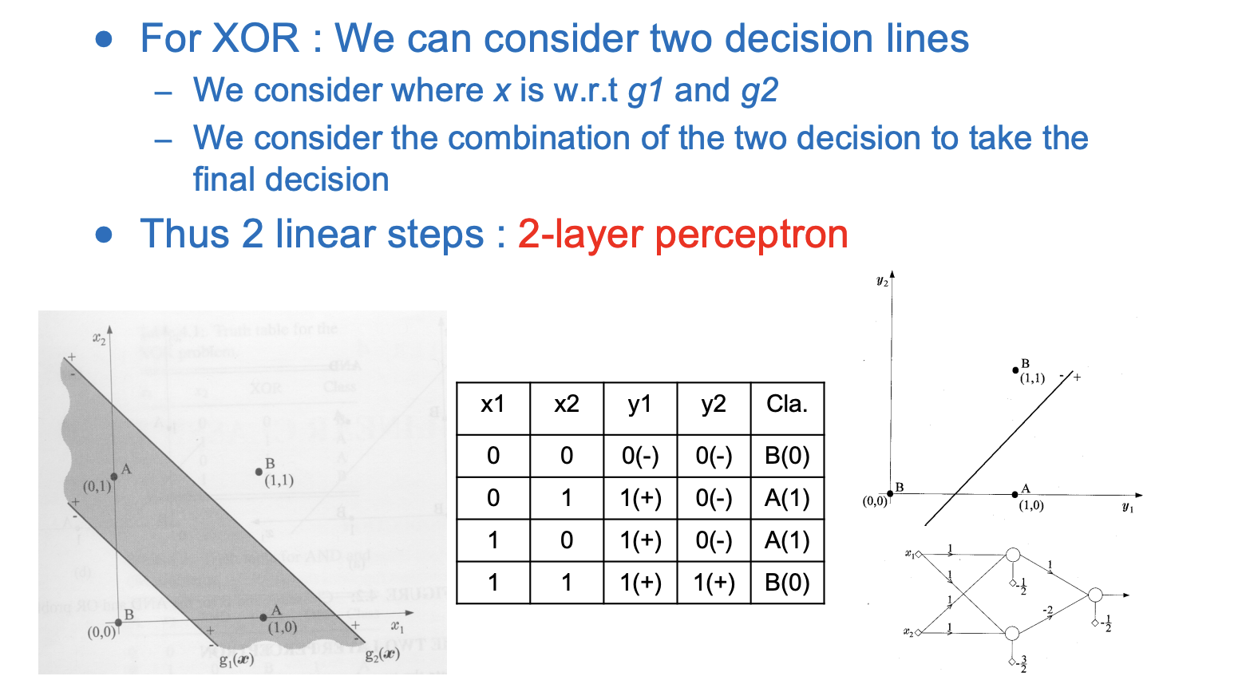
2.8. Multi-layer perceptron

Slide 43
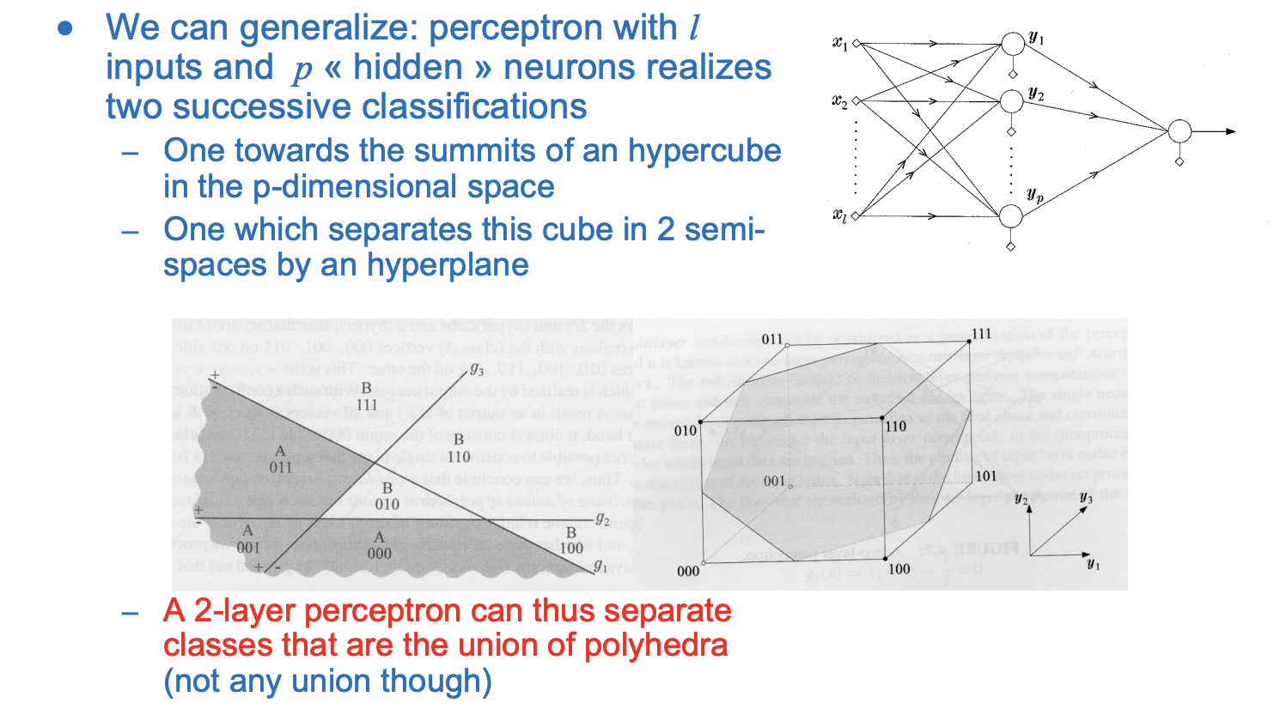
2.8. Multi-layer perceptron

Slide 44
2.9. Supervised and non-supervised classification
Supervised classification:
We have a training set, i.e. a set of feature vectors with their correct class label
We want to build a classifier that exploits this prior information
Example :
Bayesian Classifiers
Linear Classifiers
Non-linear classifiers – neural networks
Unsupervised classification: clustering
We just have a set of feature vectors, without their class label
We want to group similar vectors to create clusters and identify those clusters
Example:
k-means

Slide 45
2.10. Non-supervised classification and k-means
Unsupervised classification: clustering
We just have a set of feature vectors, without their class label
We want to group similar vectors to create clusters and identify those clusters
Example:
k-means
K-means:
Choose m centroids randomly
Iterate
Assign to each sample the class of the closest centroid
Recalculate the position of the centroids as the means of the sample for each class
Until convergence

